Slide 1
RouteMe
UWT Hackathon 4/21/2016

Slide 2
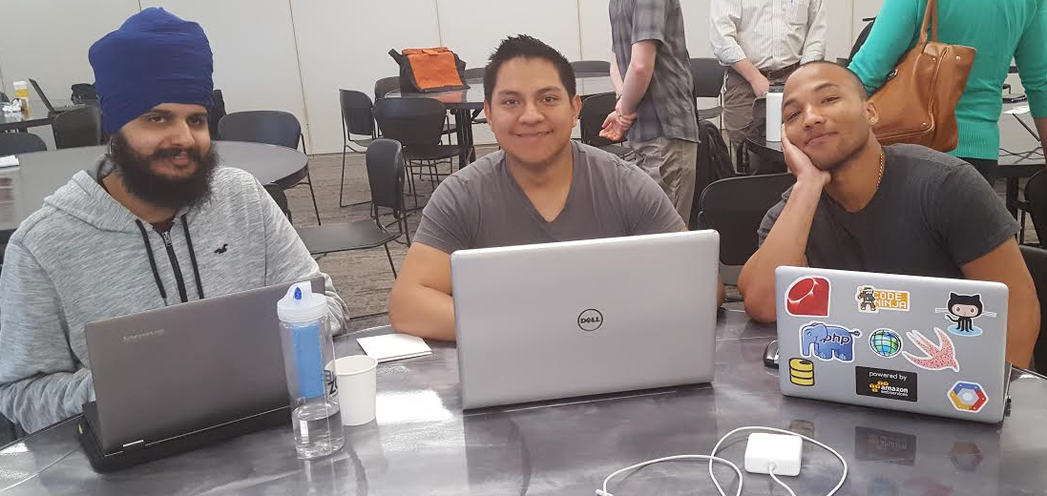
Team
Manvir Singh Audrey Chavarria Kevia Cloud

Slide 3
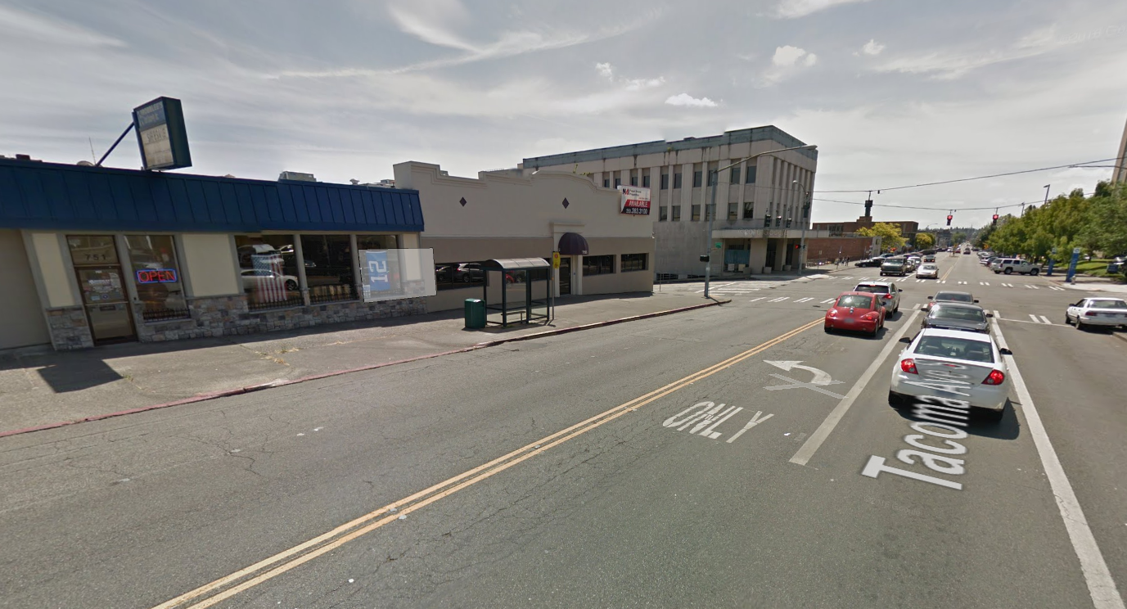
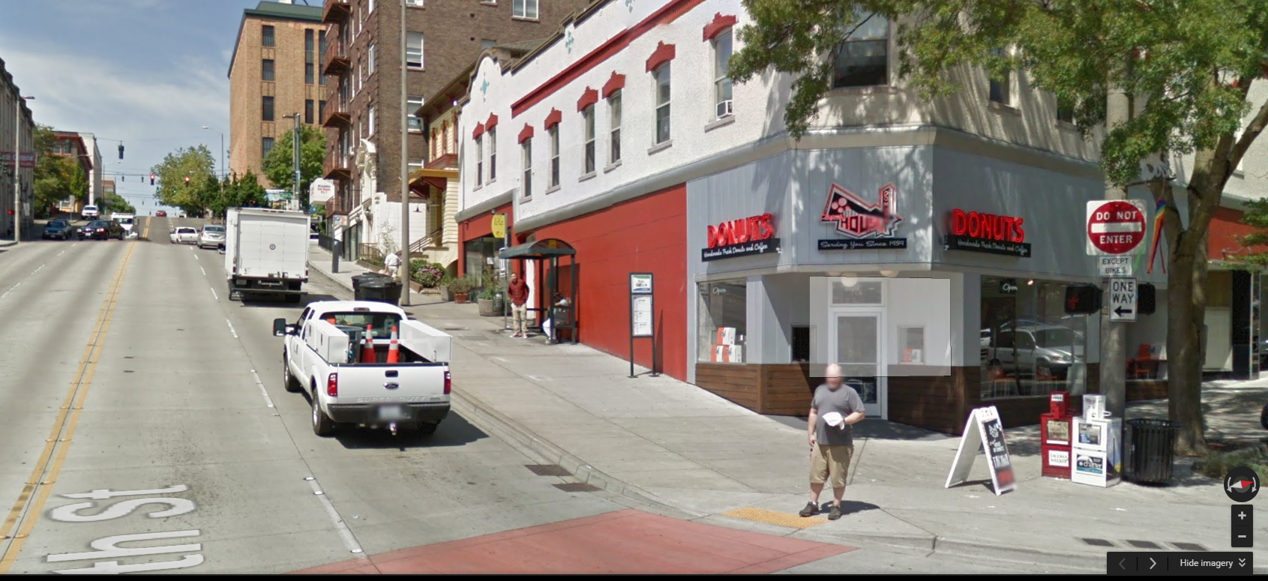
Problem encountered
When a person in a wheelchair want to use public transportation to travel to a destination they never know what their drop off location will be like:
Flat Surface
Steep Surface
Accessible
Not Accessible

Slide 4
Our idea
We wanted to build an app and web service that would help people identify the accessibility of their destination and whether they could use bus transportation or a shuttle

Slide 5
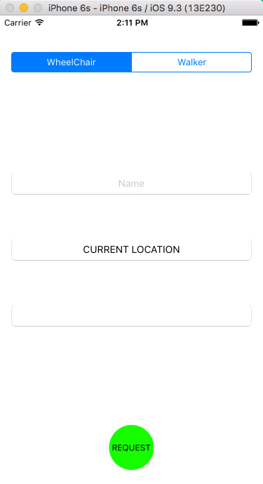
Our prototype
User lets us know if they are in a wheel chair or not
User provides their name
We identify their current location
User provides their final destination

Slide 6
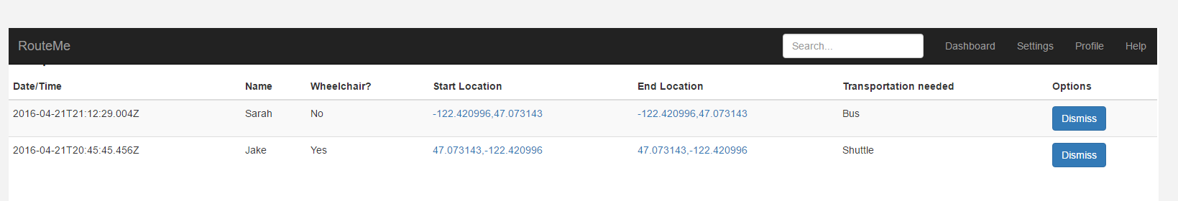
The secret formula
Our algorithm will let us determine what is best for the user:
Taking public transportation or a shuttle
Our automated system will provide possible times and routes to take
We will also connect them with shuttle providers

Slide 7
Recommendations
For the City of Tacoma & Pierce Transit
Update/Provide coordinates of bus stops with additional information about whether a bus stop is accessible for wheelchairs based on a given criteria like:
Steepness of the land
Current infrastructure of the land around the bus stop
Any objects that make the bus stop unsafe for loading/unloading of a wheelchair
This data should initially be gathered manually and then should be able to be updated later by the organizations and by public feedback on the state of such locations

Slide 8
Thank you!

